Slide 1
Four-Step Design Process

Slide 2
Reference
Kimball, R., Ross, M. (2013). The data warehouse toolkit, 3rd edition. New York, NY. John Wiley & Sons, Inc.

Slide 3
Four-Step Design Process
select the business process to model
declare the grain of the business process
choose dimensions that apply to each fact table row
identify the numeric facts that will populate each fact table row

Slide 4
Selecting the Business Process
a business process is a natural business activity, supported by a data-collection system
raw materials purchasing
order management
inventory
customer relationship management
budgeting
human resources management

Slide 5
Declare the Grain
describe exactly what an individual fact table row specifies
a line item on a retail sales ticket
a boarding pass to get on a flight
a daily snapshot of inventory levels for each product in a warehouse
a snapshot of account balances at end of each accounting period
an individual procurement transaction

Slide 6
Choose the Dimensions
the business process determines the dimensions
if the grain is clearly defined, the dimensions are normally easy to determine
dimensions should supply a rich set of descriptive data for the business process being modeled

Slide 7
Identify the Facts
to identify the facts, ask “what are we measuring?”
facts must be compatible with the grain defined in step 2
typical facts are numeric additive values such as quantity ordered or dollar cost amount

Slide 8
Retail Case Study
we have a large grocery store chain
100 grocery stores
5-state area
each grocery store has many departments: grocery, frozen foods, meat, produce, bakery, floral, health and beauty, …
approximately 60,000 products per store, identified by SKUs

Slide 9
SKUs
an SKU is a stock-keeping unit
of the 60,000 products in the grocery store, about 55,000 are from outside manufacturers and have a universal product code (UPC), which is at the same grain as an SKU
each different package variation of a product has a separate UPC and therefore also a separate SKU

Slide 10
SKUs
the remaining 5,000 SKUs are from departments within the store (meat or bakery for example) and do not have UPCs
the grocery store assigns SKUs to these products and sticks scanner labels, containing the SKU, on these products

Slide 11
Data Collection
when a customer checks out at a cash register, the bar codes are scanned directly to the point-of-sale (POS) system of the grocery store
data is also collected when vendors make deliveries, and inventory information is kept
for now, we will only be concerned with POS transactions

Slide 12
The Case Study
management is interested in studying purchasing habits of customers to determine the most effective marketing strategies
to this end, they want to build a data warehouse
the business process to be modeled is customer purchases at POS terminals

Slide 13
Retail Sales Model – 4 Step Process
business process: customer purchases as modeled by the POS system
grain: an individual line item on a POS transaction
dimensions: store, product, date, and transaction
facts: sales quantity, sales dollar amount, cost dollar amount, profit dollar amount

Slide 14
Dimension Tables
we will look at each of the dimension tables in turn
note that all dimension tables will have a surrogate key
if the dimension table also exists in the operational database and has a primary key, the primary key value is stored, but it is not used as the surrogate key in the date warehouse

Slide 15
Date Dimension Attributes
date dimension is included in virtually every data mart
this is necessary because SQL date function does not support many date attributes, such as fiscal periods and holidays
the date dimension may be relatively small: 10 years worth of days is only 3,650 rows – relatively small for a dimension

Slide 16
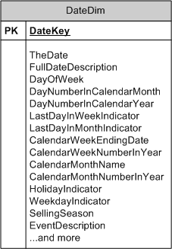
A Typical Date Dimension
Notes:
Selling season column used to indicate Christmas, Easter, etc. EventDescription used to represent a major event such as Super Bowl Sunday, or a labor strike.

Slide 17
Product Dimension
may include 50 or more attributes, including SKU (stock-keeping unit) number, product description, department code, department description, brand, weight, package type, and many more
rich set of attributes makes it easy to drill down through the data
Notes:
department code is a unique identifier for the department that this product belongs to. For example, MEAT might be the code for the meat department; department description might be “includes all meat and dairy products.”

Slide 18
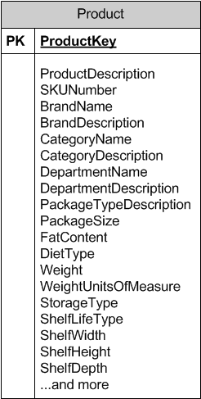
Typical Product Dimension

Slide 19
Product Dimension
recall that stores carry about 60,000 SKUs
however, because merchandise changes and we store historical data for products that are no longer carried, we expect at least 150,000 rows in this table – but perhaps as many as a million

Slide 20
Product Dimension
while we may have 150,000 distinct SKUs, there may be only 50 different values of the department attribute
this means that a department description might be repeated an average of 3,000 times in the product table

Slide 21
Product Dimension
this may tempt you to normalize by creating a Department table in a 1:M relation with product, but don’t do it !
dimension table space requirements are small in comparison to the space required by the fact table

Slide 22
Store Dimension
a geographic dimension
a store can be thought of as a location
stores can be “rolled up” to any geographic attribute, such as zip, state, or city
stores can also be rolled up to store districts and regions

Slide 23
Store Dimension
it is acceptable to represent multiple hierarchies (zip, city, state and also districts, regions) in a dimension table

Slide 24
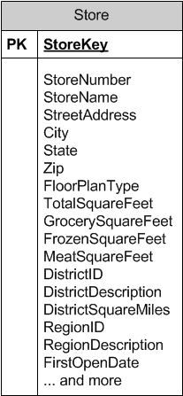
Typical Store Dimension

Slide 25
The Transaction Dimension
information from the transaction that we might want to store includes
date
store number
transaction number
except for the transaction number, the information that we want to store for transactions is already present in other dimensions

Slide 26
The Transaction Dimension
this means the only item that needs to be stored in the transaction dimension is the transaction number
because this dimension has only an identifier-like attribute and no other attributes, the POS transaction dimension is considered to be empty and is not included as a separate dimension table

Slide 27
The Transaction Dimension
the transaction dimension is referred to as a degenerate dimension
the POS transaction number is included in the fact table (with notation DD to indicate it is a degenerate dimension) and does not link to any dimension table
if we do not include the POS transaction number, we cannot pull together all the line items on a particular transaction

Slide 28
The Fact Table
unlike the dimension tables, the fact table will normally have a composite key that includes the primary keys of the dimension tables
other attributes may also be part of the primary key of the fact table
in addition, “facts” are stored in the fact table
the primary key attributes are not facts

Slide 29
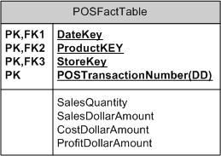
The Fact Table

Slide 30
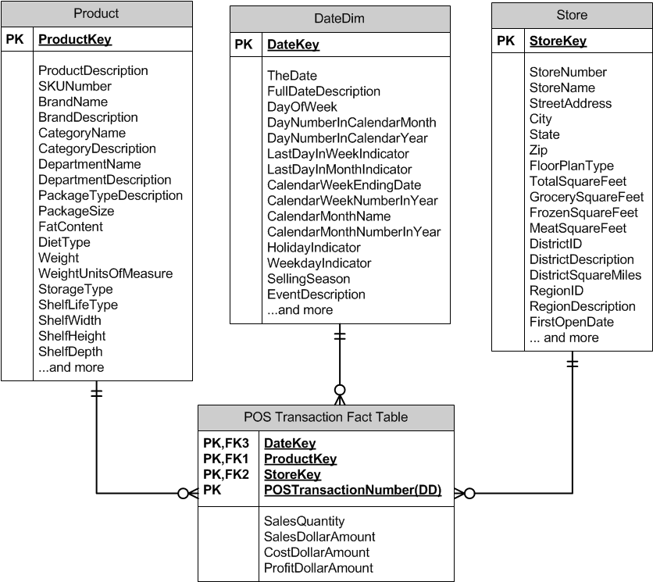
The Complete Model

Slide 31
Additive Facts
sales quantity, dollar sales amount, cost dollar amount, and profit dollar amount are additive across all dimensions
for example, consider sales quantity
we can add sales quantity for a particular product and a particular date across all stores and the result is meaningful (“the chain sold 375 8-ounce packages of Kraft’s shredded Swiss cheese on 1/5/2007”)

Slide 32
Additive Facts
we can add sales quantity for a particular store and a particular date across all products and the result is meaningful (“Piggly Wiggly Store 203 sold 3,456 individual items on 1/5/2007”)

Slide 33
Additive Facts
we can add sales quantity for a particular store and a particular product across all dates and the result is meaningful (“Piggly Wiggly Store 203 has sold 4,523 8-ounce packages of Kraft’s shredded Swiss cheese since it opened”

Slide 34
Additive Facts
we can add sales quantity for all stores and all products across all dates and the result is meaningful (“The stores in the chain have sold a total of 108,234,567 items since the chain opened its first store in 2015”)

Slide 35
Semi-Additive Facts
a semi-additive fact can be added across some, but not all, dimensions
bank balances are semi-additive
you can add across accounts (you can add the amounts of your savings and checking accounts and the total makes sense)
you can’t add across dates (adding the amounts you have in a savings account today and tomorrow does not give any meaningful information

Slide 36
Non-Additive Facts
some facts cannot be meaningfully added across any dimension
measures of intensity, such as temperatures or blood pressure, for example, are usually non-additive
it does not make sense to add the temperatures in Dallas and New York City
it does not make sense to add yesterday’s and today’s high temperature

Slide 37
Calculated Facts
profit can be calculated by subtracting the cost from the sales
in operational databases, calculated facts are generally not stored
in a data warehouse, it is common to store calculated facts – the storage cost is minor and storing it removes the possibility of user error in making the calculation

Slide 38
Things to Avoid
dimension normalization (snowflaking)
too many dimensions (centipedes)
rule of thumb is to have less than 15 dimensions
25 or more dimensions is almost always wrong

Slide 39
Surrogate Keys
dimensional tables should use surrogate keys
surrogate keys should be meaningless
do not use “smart” keys where you can tell something about the contents of the row simply by looking at the key

Slide 40
Surrogate Keys Exceptions
surrogate keys should be used for the date dimension, but unlike other surrogate keys, the date dimension keys should be assigned in a meaningful, sequential order
typically, surrogate keys are not assigned to degenerate dimensions
in the example in these slides, the actual transaction number is stored in the fact table, instead of a surrogate key

Slide 41
Four-Step Design Process
The End

